Slide 1
Learning to Segment Every Thing Ronghang Hu, Piotr Dollar, Kaiming He, Trevor Darrell, Ross Girshick BAIR, UC Berkeley Facebook AI Research (FAIR) CVPR, 2018
18110240005 王峻逸
30th November, 2018

Slide 2
Introduction
1

Slide 3
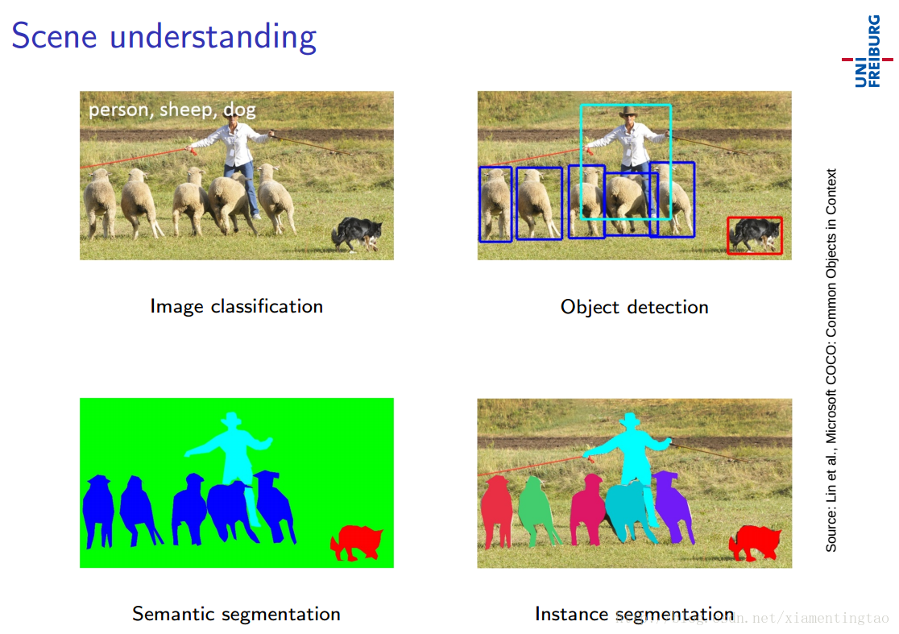
Scene Understanding Tasks

Slide 4
Motivation
Typical instance segmentation systems are restricted to a narrow slice of the vast visual world that includes only around 100 object categories.
A principle reason for this limitation is that state-of-the-art instance segmentation algorithms require strong supervision and such supervision may be limited and expensive to collect for new categories. By comparison, bounding box annotations are more abundant and less expensive.
This fact raises a question: Is it possible to train high quality instance segmentation models without complete instance segmentation annotations for all categories?
With this motivation, our paper introduces a new partially supervised instance segmentation task and proposes a novel transfer learning method to address it.

Slide 5
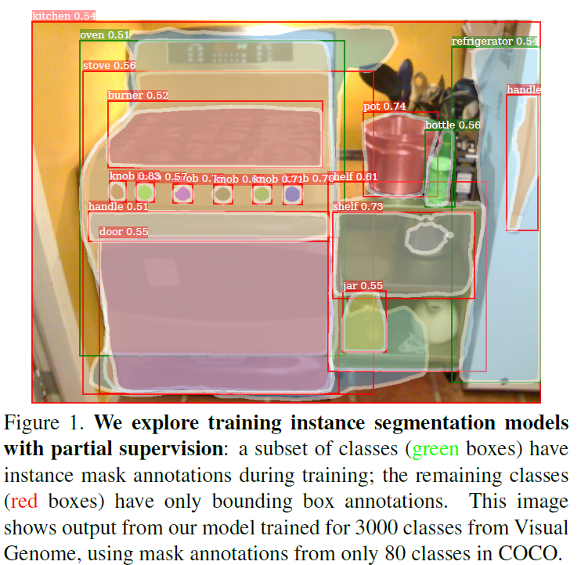
Weakly Supervised Segmentation
We formulate the partially supervised instance segmentation task as follows:
(1) Given a set of categories of interest, a small subset has instance mask annotations, while the other categories have only bounding box annotations;
(2) The instance segmentation algorithm should utilize this data to fit a model that can segment instances of all object categories in the set of interest. The training data is a mixture of strongly annotated examples (those with masks) and weakly annotated examples (those with only boxes).

Slide 6

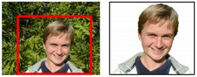
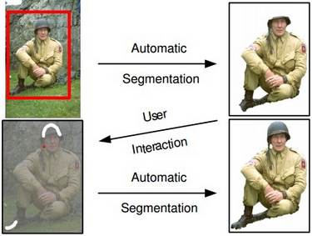
Related Work
Prior work trains semantic segmentation models from weak supervision. Image-level labels and object size constraints are used in [30], while other methods [29][4] use boxes as supervision. Point supervision and objectness potentials are used in [3].
Most work in this area addresses only semantic segmentation (not instance segmentation), treats each class independently. Weakly supervised instance segmentation is addressed in [18] by training an instance segmentation model over the bottom-up GrabCut [35] foreground segmentation results from the bounding boxes.

Slide 7
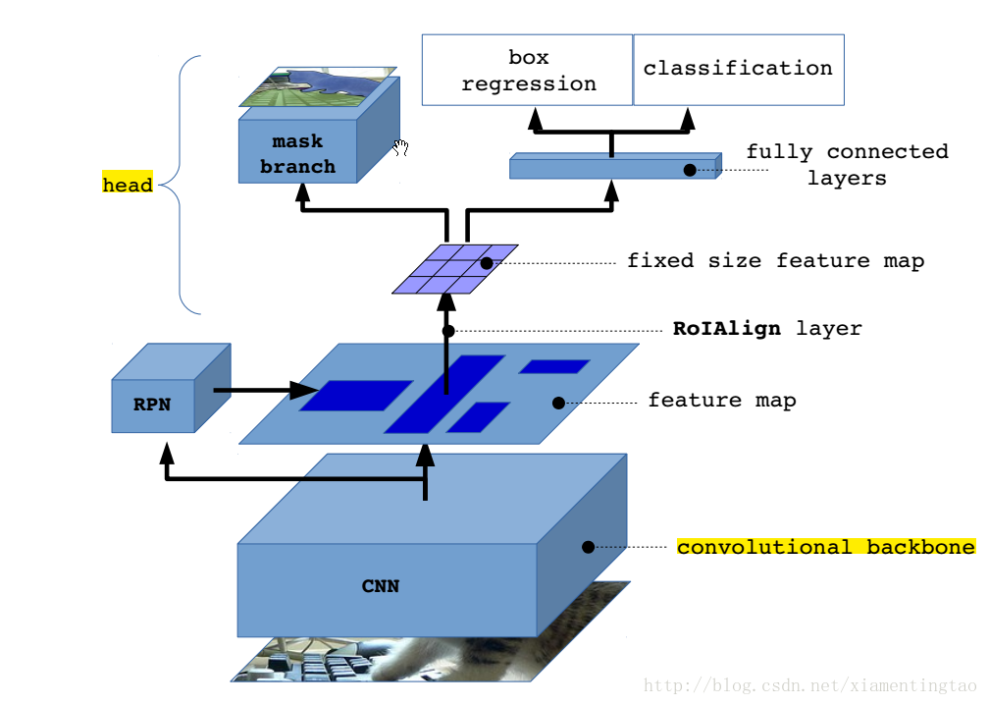
Mask R-CNN
We propose a novel transfer learning approach built on Mask R-CNN. Mask R-CNN is well-suited to our task because it decomposes the instance segmentation problem into the subtasks of bounding box object detection and mask prediction.
These subtasks are handled by dedicated network ‘heads’ that are trained jointly. Once trained, the parameters of the bounding box head encode an embedding of each object category that enables the transfer of visual information for that category to the partially supervised mask head.

Slide 8
Proposed Method
2

Slide 9
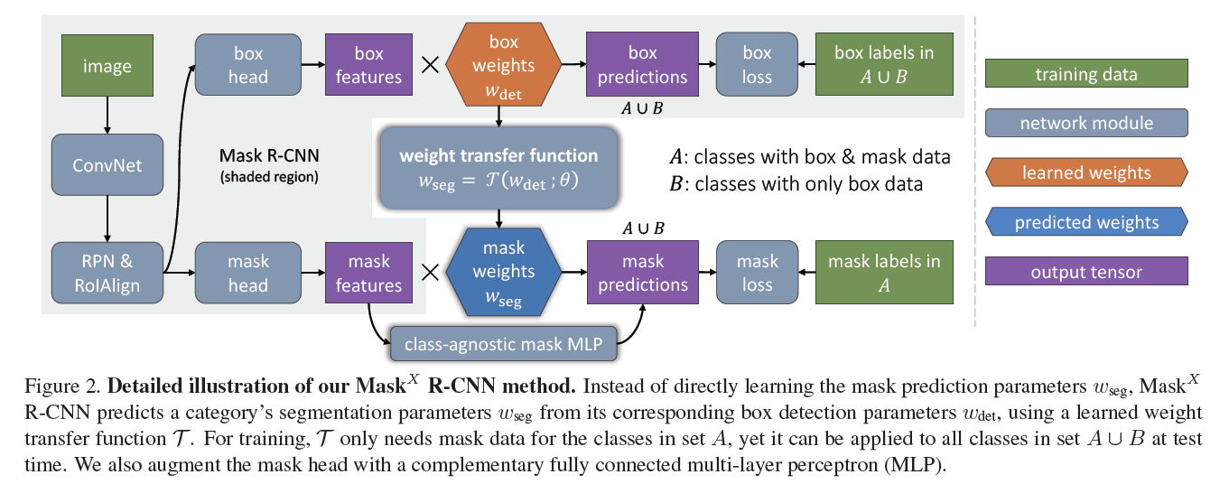
Overall Architecture

Slide 10
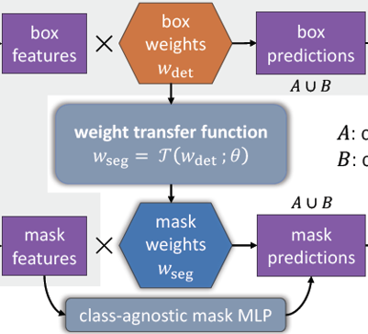
Weight Transfer Function
The weight transfer function can be trained end-to-end in Mask R-CNN using classes with mask annotations as supervision.
At inference time, the weight transfer function is used to predict the instance segmentation parameters for every category, thus enabling the model to segment all object categories, including those without mask annotations at training time.

Slide 11
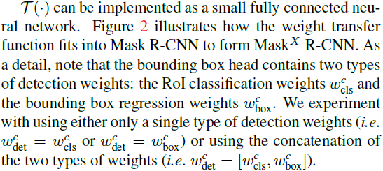
Weight Transfer Function

Slide 12
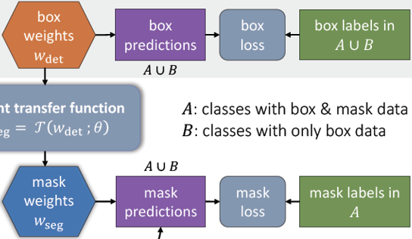
Training
During training, we assume that for the two sets of classes A and B, instance mask annotations are available only for classes in A but not for classes in B, while all classes in A and B have bounding box annotations available.
We train the bounding box head using the standard box detection losses on all classes in A and B, but only train the mask head and the weight transfer function using a mask loss on the classes in A. Given these losses, we explore two different training procedures: stage-wise training and end-to-end training.

Slide 13
Stage-wise Training
As Mask R-CNN can be seen as augmenting Faster R-CNN with a mask head, a possible training strategy is to separate the training procedure into detection training (first stage) and segmentation training (second stage).
In the first stage, we train a Faster R-CNN using only the bounding box annotations of the classes in A and B, and then in the second stage the additional mask head is trained while keeping the convolutional features and the bounding box head fixed.
This approach has the practical benefit of allowing us to train the box detection model once and then rapidly evaluate design choices for the weight transfer function.

Slide 14
End-to-end Joint Training
For Mask RCNN, multi-task training can lead to better performance than training on each task separately. The stage-wise training mechanism separates detection training and segmentation training, and may result in inferior performance. Therefore, we would also like to jointly train the bounding box head and the mask head in an end-to-end manner.
In principle, one can directly train with back propagation using the box losses on classes in A and B and the mask loss on classes in A. However, only weights for A will receive gradients from the mask loss through the weight transfer function
We take a simple approach: when back-propagating the mask loss, we stop the gradient with respect to detection weights, that is, we only compute the gradient of the predicted mask weights with respect to transfer function parameter but not bounding box weight.

Slide 15
Fused FCN+MLP Mask Head
Two types of mask heads are considered for Mask RCNN: an FCN head, where the M*M mask is predicted with a fully convolutional network, and an MLP head, where the mask is predicted with a multi-layer perceptron consisting of fully connected layers. In Mask R-CNN, the FCN head yields higher mask AP.
However, the two designs may be complementary. Intuitively, the MLP mask predictor may better capture the ‘gist’ of an object while the FCN mask predictor may better capture the details (such as the object boundary). Based on this observation, we propose to fuse them with predictions from a class-agnostic MLP mask predictor.

Slide 16
Experiments
3

Slide 17
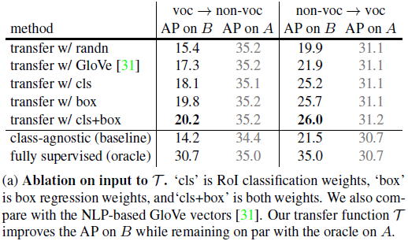
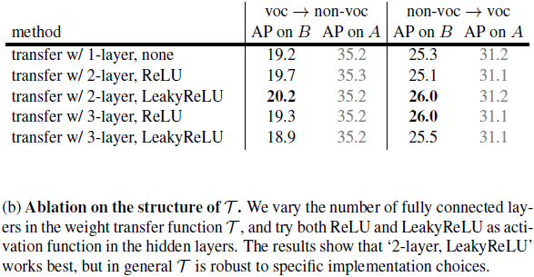
Ablation on Weight Transfer Function

Slide 18
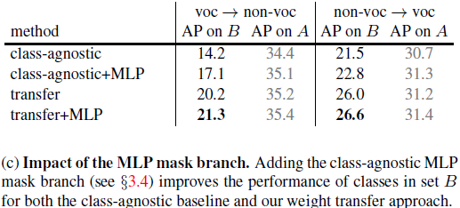
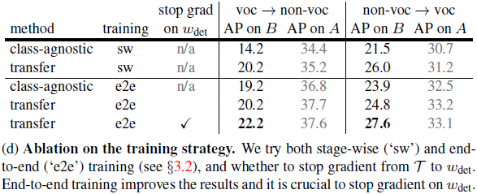
More Ablation

Slide 19
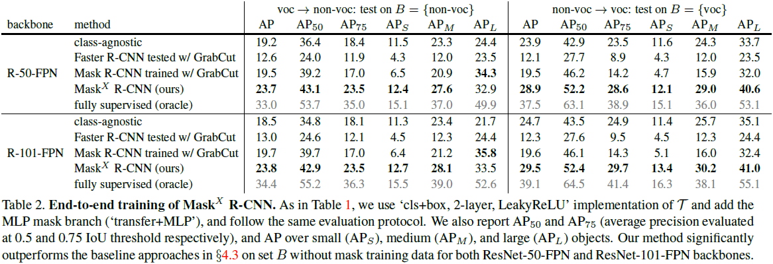
Full Method Comparison

Slide 20
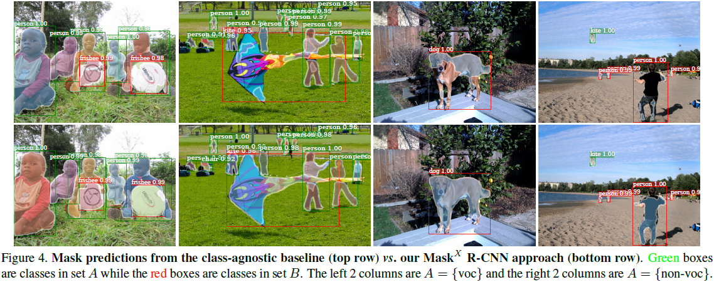
Results

Slide 21
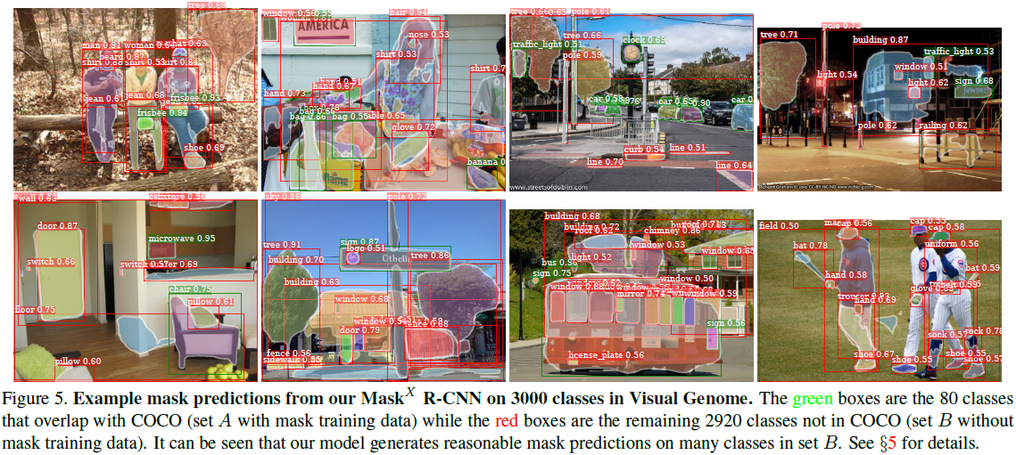
Results

Slide 22
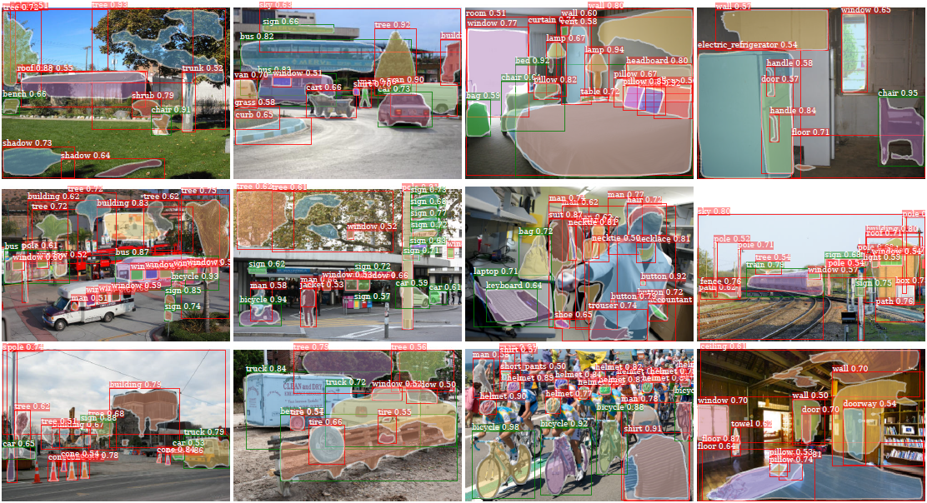
Results

Slide 23
Conclusion
4

Slide 24
Conclusion
This paper addresses the problem of large-scale instance segmentation by formulating a partially supervised learning paradigm in which only a subset of classes have instance masks during training while the rest have box annotations.
We propose a novel transfer learning approach, where a learned weight transfer function predicts how each class should be segmented based on parameters learned for detecting bounding boxes. Experimental results on the COCO dataset demonstrate that our method greatly improves the generalization of mask prediction to categories without mask training data.
Using our approach, we build a large-scale instance segmentation model over 3000 classes in the Visual Genome dataset. The qualitative results are encouraging and illustrate an exciting new research direction into large-scale instance segmentation.

Slide 25
Thank you for listening

